Slide 1
Understanding Pro-Bono Ethics and Colorado Cannabis Laws: A Primer for volunteer attorneys to assist Colorado Social Equity in Cannabis Applicants Presented by Rachael Z. Ardanuy, Esq. on August 25, 2022

Slide 2
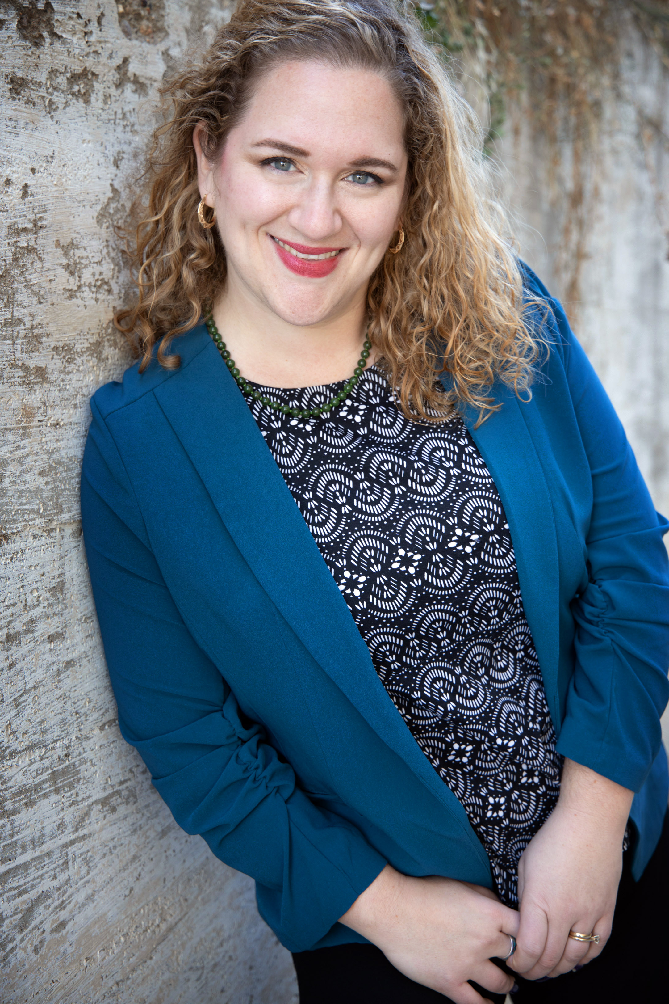
About Me
Founder of Denver-based Cannabis Business Law Firm RZA Legal
Licensed attorney in Colorado, Florida & New Jersey
7+ years representing licensed marijuana & hemp growers, manufacturers, retailers, hospitality, and their business partners (landlords, vendors, ancillary companies, investors, employees, etc.)
Cannabis policy & regulatory expert
Professional affiliations: Colorado Bar Association Cannabis Law Section (immediate past chair), New Jersey State Bar Cannabis Law Special Committee, American Bar Association Cannabis Law and Policy Committee (vice chair), NORML Legal Committee, National Cannabis Industry Association, International Cannabis Bar Association

Slide 3
Agenda
More Ethical Concerns
Colorado commercial cannabis industry
Social Equity – What is it and who qualifies?
Common issues facing Social Equity applicants
Business ownership structure & choice of entity
Business licensing process – state and local
Real Estate (due diligence, zoning, occupancy, lease and sales agreements)
Contracts (LOIs, leases, financial source, IP licensing, vendor, and employment agreements)
Regulatory compliance
Potential pitfalls to avoid & other resources

Slide 4
Which Rules Apply? All of Them!
In certain respects, advising clients in the Cannabis industry is no different than advising clients in any other business venture. Putting aside the historical illegality of growing, producing, possessing and using marijuana, regulating lawyers who represent and advise those in this industry is much the same as regulating and other business lawyers. All of the Rules of Professional Conduct flowing from such an attorney-client relationship apply.
Those that warrant particular emphasis include:
Rule 1.1 – Competence.
Rule 1.2 – Particularly avoiding assisting clients in criminal or fraudulent conduct.
Rule 1.4 – Communication in what may be an ever-changing regulatory environment.
Rule 1.5 – Fees and concerns with “creative” fee arrangements.

Slide 5
Which Rules Apply? All of Them!
Rules Continued…
Rule 1.6 – Confidentiality in a highly-competitive business environment.
Rules 1.7, 1.9 and 1.10 – Conflicts of interest due to representation of multiple clients in the same industry, conflicts due to personal interests, conflicts regarding former clients and imputed disqualification.
Rule 1.8 – The many pitfalls of business relationships with clients and accepting an ownership interest in a business venture in lieu of fees.
Rule 1.13 – Organization as a client.
Rule 1.15 and safekeeping of property (some unique issues in what is currently an all-cash business in many jurisdictions).
Rule 8.4(b) – Criminal conduct.

Slide 6
Colorado Cannabis Commerce
(2000) Amendment 20 legalized medical marijuana in CO
(2012) Amendment 64 legalized adult use cannabis & commerce in CO
There are intersecting laws (CRS 44-10-101 et seq) and rules (1 CRR 212-3) all cannabis business licensees must abide by
Sometimes these laws and regulations overlap, sometimes the regulations go farther since laws authorize MED to do rulemaking applicable to the regulation of cannabis businesses)
Gap between policy and reality leads to necessary interpretation of laws and regulations to figure out how to compliantly operate – attorneys are trained in legal interpretation.

Slide 7
Social Equity in the Cannabis Industry
What is “Social Equity” and why is it important? ⎼ Social Equity initiatives aim to provide equal opportunities for all people while taking into account systemic inequalities and their disproportionate impact on certain groups.
Systematic Inequalities ⎼ In every single US state, black people are arrested at higher rates than white people for cannabis possession, despite equivalent use between the two demographics.
Inequalities Persist ⎼ In CO, these discrepancies persist after cannabis legalization; prior convictions can impede career in income growth, access to capital, etc.
Impact on the CO Cannabis Industry ⎼ Until 2019, CO severely restricted individuals with past cannabis convictions from participating in the legal cannabis industry.
A Priority for Governor Polis ⎼ Legislation enabling Social Equity initiatives should promote equity, diversity, and inclusion in the cannabis industry measured by an increase in minority-ownership of cannabis businesses.

Slide 8
Social Equity ⎼ Legislative History
2019 ⎼ SB19-224: Colorado legislature created accelerator cultivators and accelerator manufacturers allowing an “Accelerator-Endorsed Licensee,” to provide technical and capital support to the accelerator licensee.
2020 ⎼ HB20-1424 was signed into law, expanding the existing accelerator program and creating the current social equity cannabis licensing regime.
Established qualifications and a statewide definition for which businesses qualify as cannabis business license SEAs.
Expanded the accelerator program to include retail dispensaries and provided that both the hosting licensee a social equity licensee may be entitled to incentives from the department of revenue or the office of economic development and international trade” (“OEDIT”)
Provided rulemaking authority for the Department of Revenue to create and implement a social equity program administered by the Colorado Marijuana Enforcement Division (“MED”).
March 21, 2021 ⎼ SB21-111 was enacted to create a program in the OEDIT to support entrepreneurs in the marijuana industry, which will primarily assist social equity licensees. From this, the Cannabis Business Office (CBO) was established.
Currently ⎼ available social equity license types include either stand-alone or accelerator licenses for retail cultivation, manufacturing, and dispensing.

Slide 9
Social Equity Qualification Criteria
Those seeking a license under Colorado’s current Social Equity Program must fit the following social equity criteria:
The Applicant must be a Colorado resident, and
The Applicant must not have previously owned a marijuana business that had its business license revoked, and
At least one of the following:
The Applicant resided for at least 15 years (between 1980 and 2010) in a census tract designated by the Colorado Office of Economic Development and International Trade as an Opportunity Zone or designated as a “Disproportionate Impacted Area”; or
The Applicant or Applicant’s parent, legal guardian, sibling, spouse, child, or minor in their guardianship was arrested for a marijuana offense, convicted of a marijuana offense, or was subject to civil asset forfeiture related to a marijuana investigation; or
The Applicant’s household income in a year prior to application did not exceed 50% of the state median income as measured by the number of people who reside in the Applicant’s household.

Slide 10
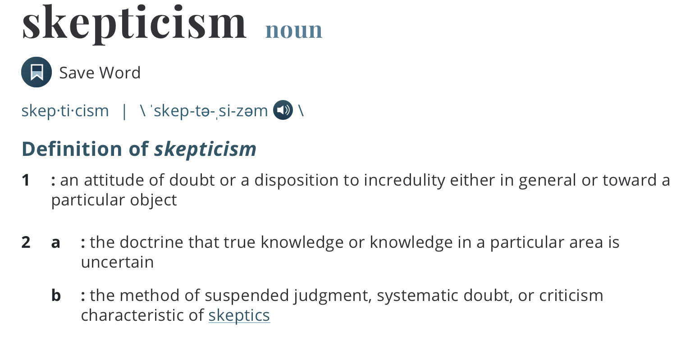
Skepticism about legal representation in cannabis
Lawyers
Ethics concerns
Lack of precedent or experience
Clients
Risk of documentation
History of handshake deals
Mistrust of lawyers
Lack of experience

Slide 11
We are more alike than you think
Lawyers
Subject to licensure from the state that must renew annually
Background checks and financial commitment to receive licensure (law school, bar exam)
Subject to robust regulations (Rules of Professional Conduct)
Limited in advertising
Business owners
Requires niche understanding of specific subject matter (law)
High stress
Cannabis Business Clients
Subject to licensure from the state that must renew annually
Background checks and financial commitment to receive licensure (start up-capital)
Subject to robust regulations (Colorado Marijuana Code)
Limited in advertising
Business owners
Requires niche understanding of specific subject matter (weed)
High stress

Slide 12
Issues facing Social Equity Applicants
The process to establish your business entity, obtain business licensure, then get operational involves many moving parts, some of which are “legal” in nature, some of which are “business” in nature
Attorneys have the training and skills to guide clients on:
“Legal” issues: contract negotiation and drafting, representation before gov’t agencies for license approval or license defense, rule interpretation and licensing pre-conditions
Regulatory issues: packaging and label compliance, SOPs, recalls, regulatory investigations, best practices for recordkeeping, IP licensing, advertising
“Business” issues: customary or advantageous contract terms, timing issues on lease/RE deals, educating non-cannabis business counterparts (landlords, vendors, investors, etc.), licensing applications, identifying multi-disciplinary issues (tax, real estate/zoning, fundraising, employment, criminal defense, dispute resolution, debt collection
For more on Social Equity in the Cannabis Industry, check out my associate, Lauren Devine’s award-winning Law Review Comment, The Ethics & Economics of Social Equity in the Cannabis Industry: Making a “Compelling” Case for Constitutional, Impactful, & Sustainable Inclusivity Programs in Ohio & Beyond, published by the University of Dayton School of Law.

Slide 13
Business Ownership Structure
Choice of Entity – LLC, partnerships, corporations (C- or S-)
Taxes (hello CPA!)
Fundraising & Investor preferences
Leadership Vision
Succession Planning (exit strategy)
Public Benefit
Availability of Incentive Stock Options
Licensing authorities require submission of charter documents so registration with the SOS alone not sufficient

Slide 14
Business Licensing Process
State – Colorado Department of Revenue – Marijuana Enforcement Division
Finding of Suitability Application submission (fingerprints, bank records)
Business License Application submission to MED with supporting documents
Conditional on receipt of local licensing approval
MED website
Local (example: Denver)
Submit license application after submission of state Business License Application to MED via online portal with supporting documents
Public hearing requirement for stores, hospitality, and hospitality & sales licenses
Burden of Proof
availability of licenses in the ‘hood
whether issuance would create undue concentration
needs & desires of adults of the ‘hood
Inspections Process
Denver marijuana licensing website

Slide 15
Real Estate Matters
Suitability (proximity limitations, neighborhoods of undue concentration)
Letters of Intent (LOI)
Commercial Lease negotiation and drafting
Due Diligence
Purchase Agreements
Zoning
Occupancy and Use
Building your team of necessary real estate professionals
architect, electrical, mechanical, plumbing engineer, surveyor, designer

Slide 16
Cannabis Contracts
Operating Agreements & Shareholder Agreements
Leases & Real Estate Purchase Agreements
Manufacturing Agreements
IP Licensing Agreements
Employment Agreements
Vendor Agreements (delivery, supplier, distribution, marketing, staffing)
Asset/Stock Purchase Agreements

Slide 17
Unique Clauses in Cannabis Contracts
Contingencies on licensing
Due diligence in asset purchases (licenses, facilities)
Carve out references to compliance with federal law
Good faith renegotiation in light of regulatory change requests/requirements
Security, remedies in light of no access to BK, seller carry terms
Automatic Divestiture in charter documents
Valuation of licenses, inventory

Slide 18
Negotiating & Drafting Tips
Operating Agreements & Shareholder Agreements
Auto divestiture, limits on transfers, subject to regs
Leases & Real Estate Purchase Agreements
Rent abatement & termination conditional on licensure
TI, FF&E, allowable security, Landlord access limits
Options to expand/extend/buy
Bifurcated/conditional closing
Asset Purchase Agreements
Operations-specific due diligence, termination clauses based on regulatory approvals, escrow options

Slide 19
Negotiating & Drafting Tips
IP Licensing Agreements
Metrics for royalties, manufacturing space commitments, sales responsibilities, QC
Employment Agreements
Defining & implementing “for cause” policies related to termination due to regulatory matters to protect business licenses
Vendor Agreements (delivery, supplier, distribution, marketing, staffing)
All actors working in compliance with regulatory requirements for badging, security, licensing/permitting

Slide 20
Potential Pitfalls to Avoid
Using a contract template from a non-cannabis business matter thinking it will be sufficient
Unfamiliarity with current cannabis regulations – state and local
Relying on accurate regulatory knowledge of
“consultants”
the lawyer on the other side of a deal
your realtor
your cousin’s friend’s brother who worked at a dispensary
internet searches or social media

Slide 21
Other Resources
Cannabis Law Section members – attend monthly meetings, ask questions of membership on listserv via CBA Communities
Denver & Colorado technical assistance programs
Colorado Cannabis Business Office
Cannabis Law in Colorado – First Edition

Slide 22
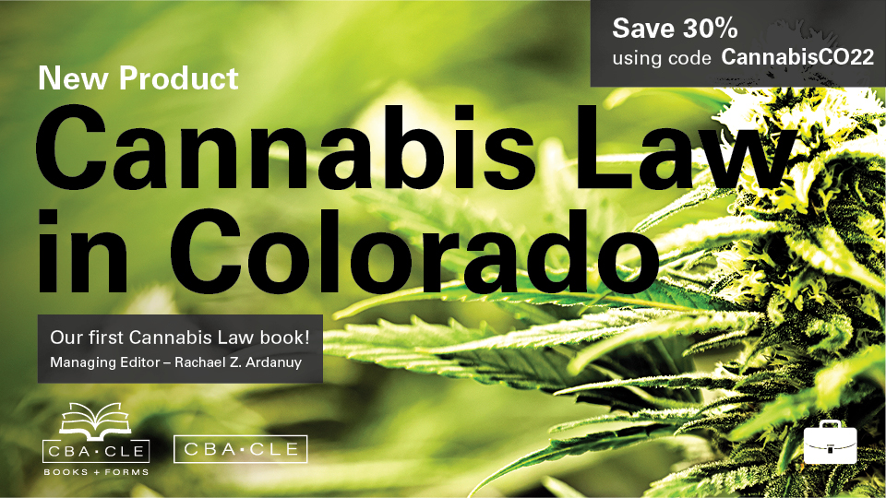

Slide 23
Pro Bono Referral Program Details
Colorado Bar Association Cannabis Lawyers for Social Equity pro bono referral program for free 30-minute consultation with volunteer cannabis attorney.
Next Step: Sign up to volunteer:
https://www.cobar.org/For-Members/Sections/Cannabis-Law-Committee
Questions or Suggestions? Contact me: Rachael@RZALegal.com

